Slide 1

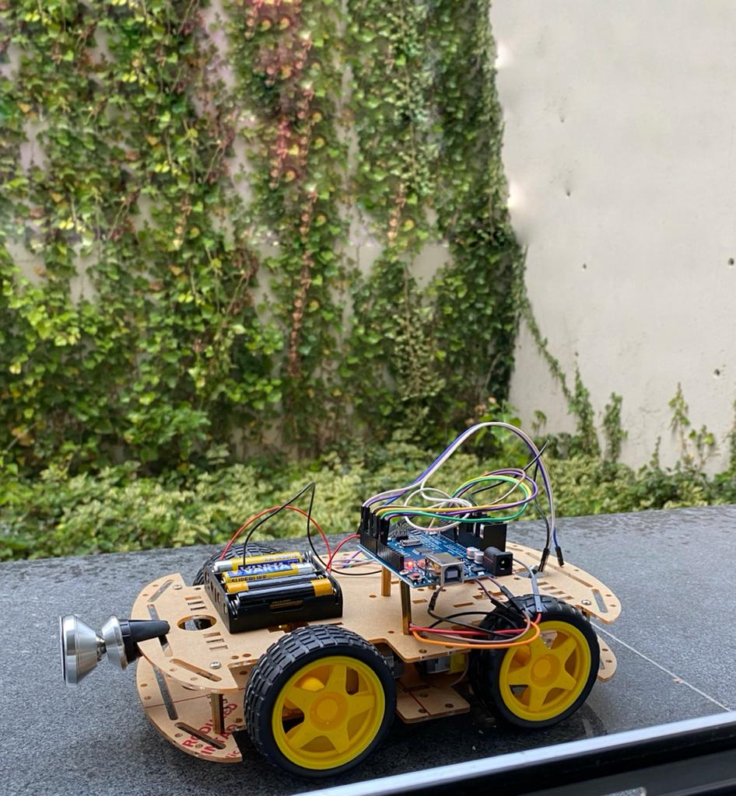

Autonomous Vehicle
KAŞİF UGV

Slide 2
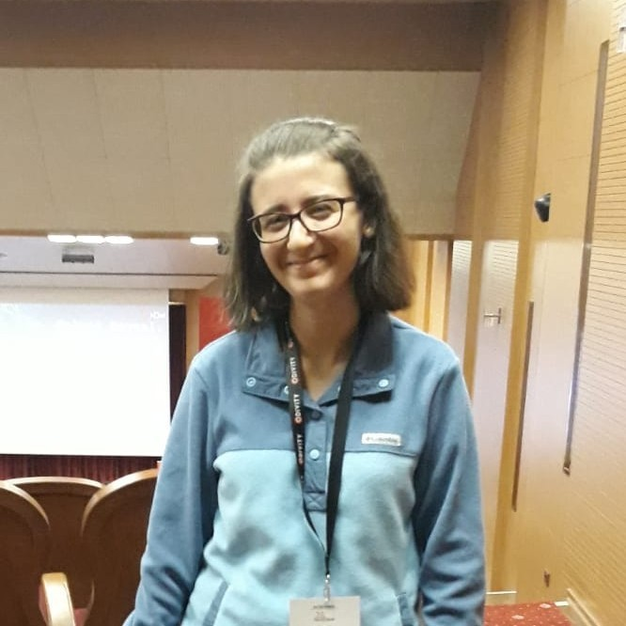
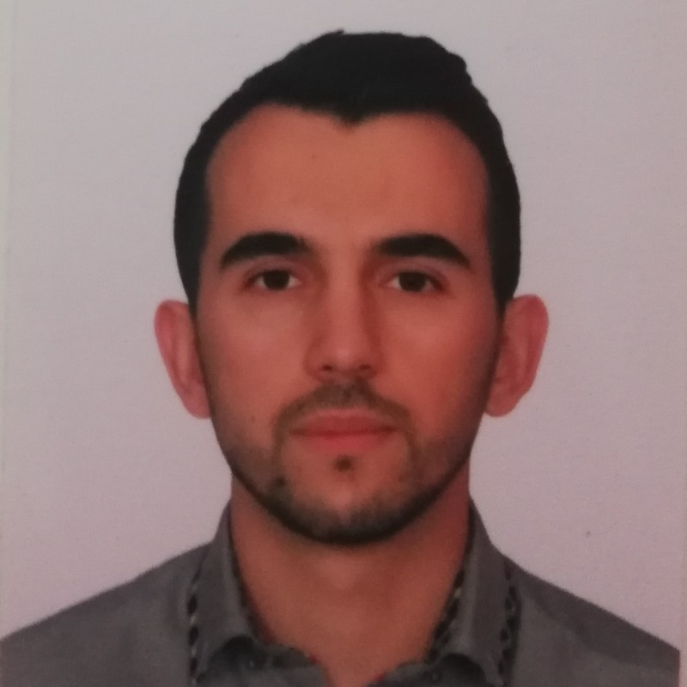

OUR ADVISOR
DR. SERDAR ARSLAN
OUR TEAM
EYLÜL ERDOĞAN
ALİ BOZDOĞAN
ALEYNA DEDE
201711025
201717009
201711019

Slide 3
TABLE OF CONTENTS
01
02
03
04
05
06
PROJECT DEFINITION
MAIN FEATURES
MAIN CONTRIBUTION
WORK PLAN
MATERIALS & METHODS
POTENTIAL RISKS
07
08
09
EXPECTED OUTPUTS
OBTAINED RESULTS & DEMO
QUESTIONS

Slide 4
PROJECT DEFINITION
In our project, it is aimed to develop national unmanned ground vehicle which acts as a spy or guardian of a field.
Therefore, our project will not be only self-driving car, it will also be able to detect objects which can be threads, enemies, suspicious objects, or events.

Slide 5
MAIN FEATURES
01
02
03
Object Detection for upcoming threads
Object Detection for spying
Capability of autonomous and manual driving

Slide 6
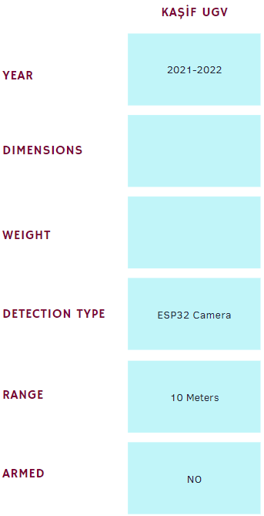
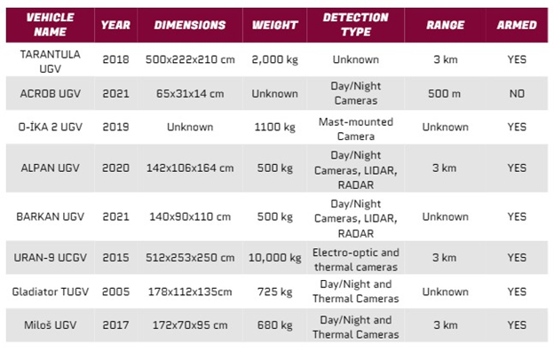
MAIN CONTRIBUTION
2021-2022
Height = 31 cm Width = 3.5 cm
0.866 kg
ESP32 Camera
10 meters
No

Slide 7
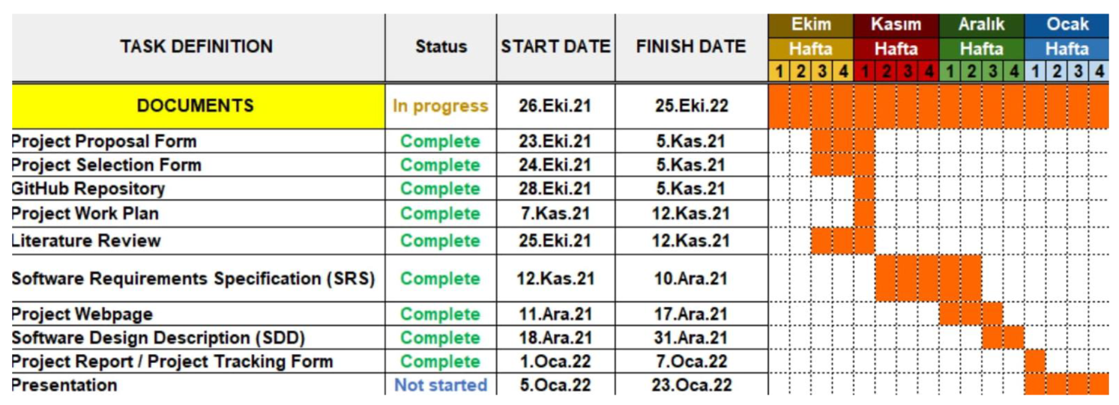
WORK PLAN

Slide 8

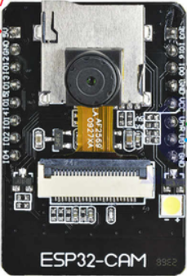
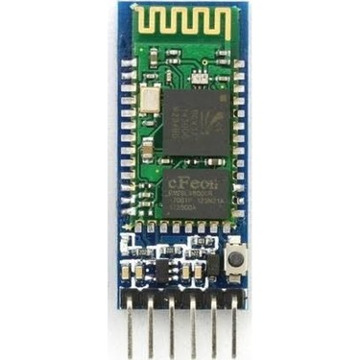
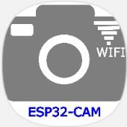
MATERIALS
ESP32 AI CAM APPLICATION
BLUETOOTH RC CAR APPLICATION
ESP32 CAMERA
CONTROLLER USING HC05
We use it to receive real time video from KAŞİF UGV.
We use it to operate KAŞİF UGV manually.
Real time video is sent from ESP32 Camera module.
Vehicle is enabled to control manually using HC05 Bluetooth module.

Slide 9
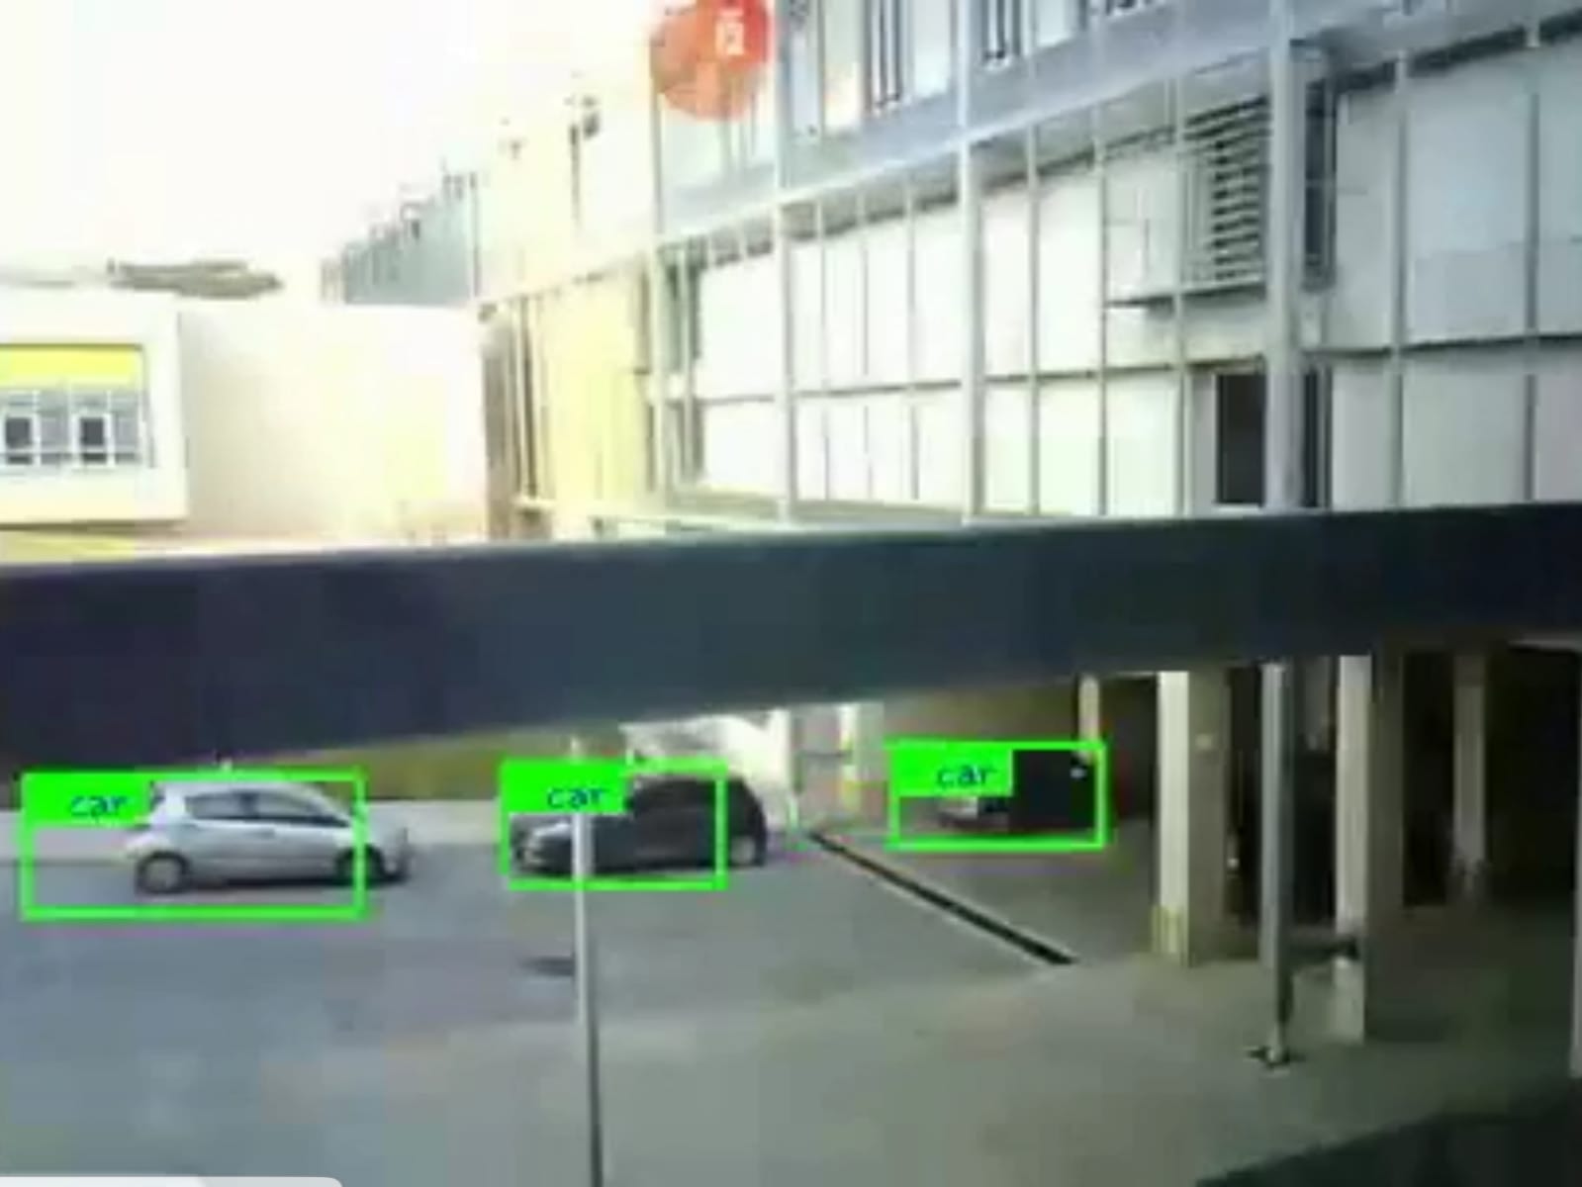
YOLO
METHODS
We used YOLO Object Detection Technique since it provides satisfying accuracy and speed results. The obtained results will be shown in demo.

Slide 10
POTENTIAL RISKS
01
03
Autonomous Mode may not work as it is expected.
For such case, we will support our system with additional or better sensors and software.
As the object detection algorithm improves, the FPS that we obtained may decrease.
For that purpose, we can provide faster Internet connection or make the algorithm running more efficient.
02
Our improved dataset may not be enough to detect variety of threads.
For such case, we can try to import specific objects to our dataset.

Slide 11
POTENTIAL RISKS
04
06
ESP-32 CAM module send video continuously via Wi-Fi. Therefore, Wi-Fi password must be protected to prevent leaks.
Since we set password in our source code, it must be carefully saved in computer or external hard drive.
Our vehicle can move manually. Therefore, anyone who has a smartphone can easily connect to our Bluetooth module.
To prevent this, our module asks pin before connection is completed.
05
We will develop an application which displays video sent from ESP-32 CAM. Therefore, if apk file of our application is leaked, it could cause threats.
Therefore, apk file of application must be also protected.

Slide 12
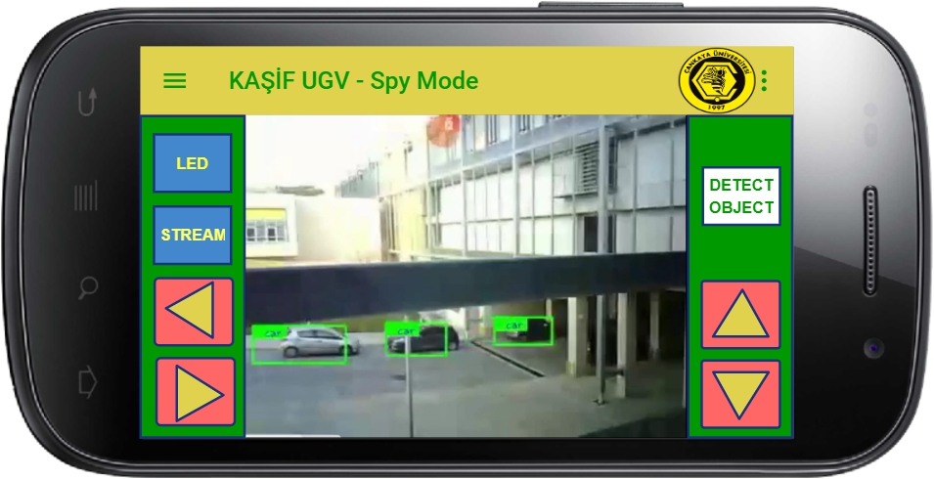
EXPECTED RESULTS
01
Implementing our own software for controlling car and receiving real time video.

Slide 13
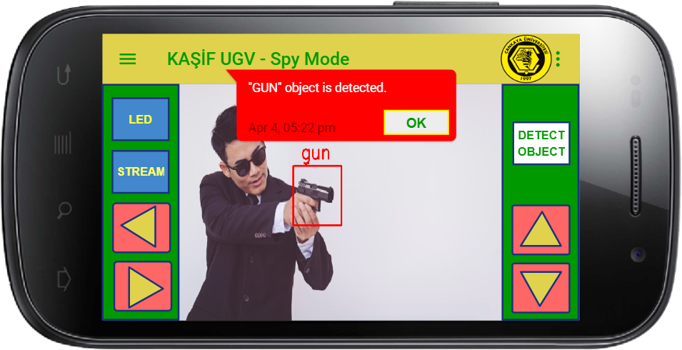
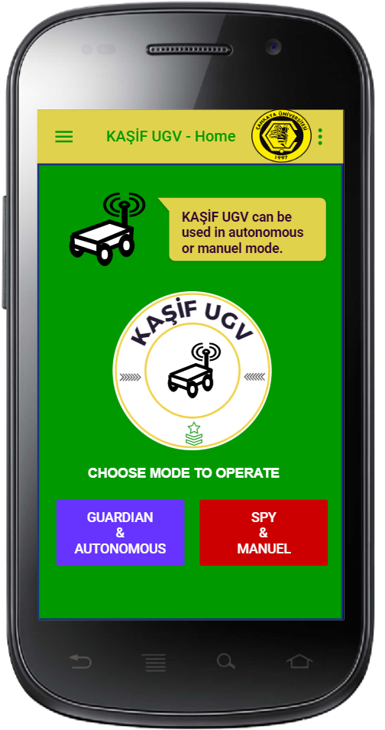
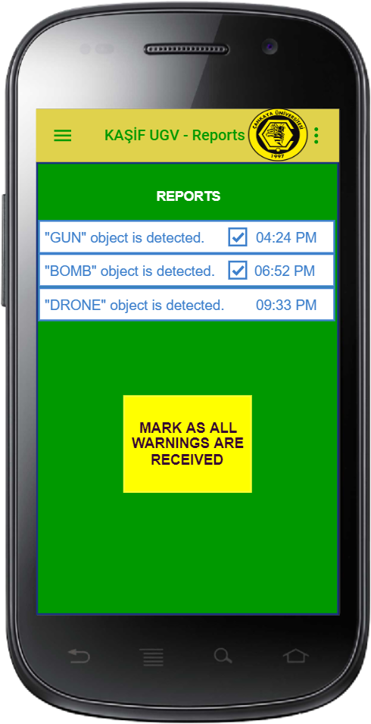
EXPECTED RESULTS
02
Implement additional features to that software. These features will be as follows :
Warning messages when object identified as thread.
Selection GUI for both self-driving and manual modes.
Saving and displaying the threads/objects that are detected in another page.

Slide 14

EXPECTED RESULTS
03
Making the vehicle capable of self-driving.

Slide 15
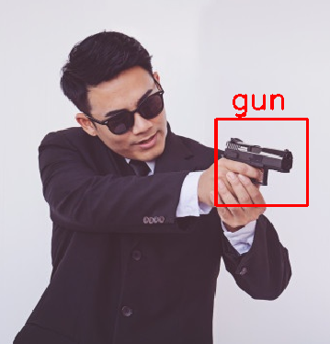
EXPECTED RESULTS
04
Expanding our dataset or improving the algorithms we used to receive better results on suspicious objects or threads.

Slide 16


OBTAINED RESULTS
Real Time Video
Object Detection
Manuel Driving
Assembly
Real Time Video is Received by Module succesfully.
Object Detection algorithms are tested continuously.
Manuel driving implementation is completed.
Car prototype is assembled.

Slide 17
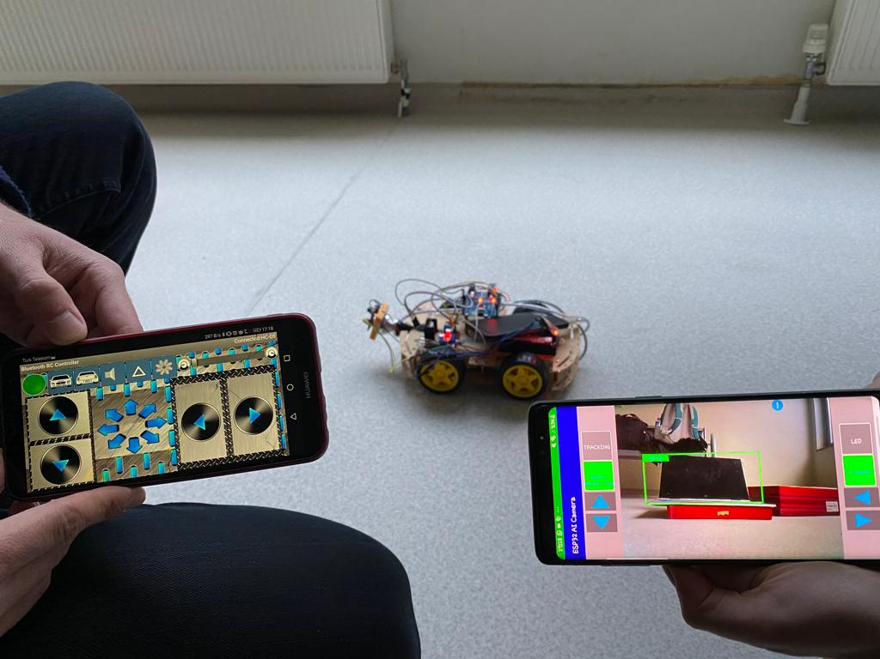
DEMO
OUR DEMO VIDEO CAN BE REACHED USING BELOW LINK:
https://www.youtube.com/watch?v=kkanOoQVD4A

Slide 18

THANK YOU!
QUESTIONS?

